Slide 1
EMERGENCE OF THE MODERN WORLD ECONOMY

Slide 2
Introduction
This is a reprise of parts of the previous two lectures (about empires and the birth of capitalism) but cast in terms of certain socio-economic principles and types of economy and the shifting balance between these over time.
The lecture begins with a brief overview of ideas taken from two writers: Karl Polanyi and Immanuel Wallerstein. These are then used to portray the central features of the modern world economy from the 1500s to the present.
This leads to a discussion of the early European “world economy” and how this expanded worldwide.
A final section considers: why Europe? A visiting Martian in 1500 might have bet on China. That would have turned out to be a bad bet because the very things that were China’s strengths were the very things that “kept it at home” compared to the expansionist Europeans.

Slide 3
PRINCIPLES OF ECONOMIC INTEGRATION AND TYPES OF ECONOMY
Dominant Principle: Type of Economy:
1. Reciprocity 1. Mini-systems
2. Redistribution 2. Empires
3. Market exchange 3. World economies
(Karl Polanyi) (Immanuel Wallerstein)

Slide 4
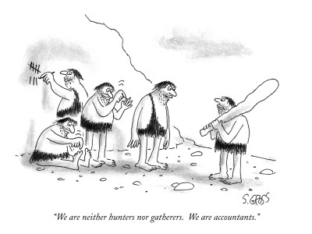

Slide 5
MODERN WORLD ECONOMY
Only possible with rise of market exchange as dominant principle:
(1) parties not necessarily known to one another, separated by long distances
(2) prices set in markets for goods and services
(3) loans and interest for advance finance
(4) insurance for risk/trust issues
(5) reliable currencies backed by gold/silver
(6) market places (fairs, banking seats, merchants, bankers)

Slide 6
The other principles?
Reciprocity survives in kinship preferences/family capitalism
Redistribution as basic principle of empire building – trade preferences, restrictions on production to favor “home” country – but also autarkic development (such as former Soviet Union 1917-1991) and welfare states
They have hardly died out.
Some countries and businesses (as monopolies) continue the attempt to turn world economies into empires.

Slide 7
THE EARLY EUROPEAN WORLD ECONOMY
15th to 16th Centuries in Western Europe (particularly in present-day northern Italy and the Netherlands):
City states (as centers of market exchange)
Merchant class
Banking and usury/insurance
Limited liability company
Increased productivity in agriculture and manufacturing
Discovery of world “over the horizon”
Concurrent empire building (mainly Spain and Portugal) introduced new stocks of gold and silver

Slide 8
EXPANSION OF WORLD ECONOMY 16th Century to Present
Blend of market exchange and redistribution (colonialism). European colonial empires were particularly redistributive: drawing in resources from colonies and then investing in inside-out infrastructure and selling manufactured goods to captive markets (see Figure 1; double click below the date to move the animation)
Periods and world regions in which market exchange has prevailed (Western Europe in 16th Century, early 18th Century Europe, late 19th Century Europe and North America)
Since mid-20th Century market exchange has risen to greatest worldwide prominence (end of empires, collapse of state-based economies such as the Soviet Union)

Slide 9
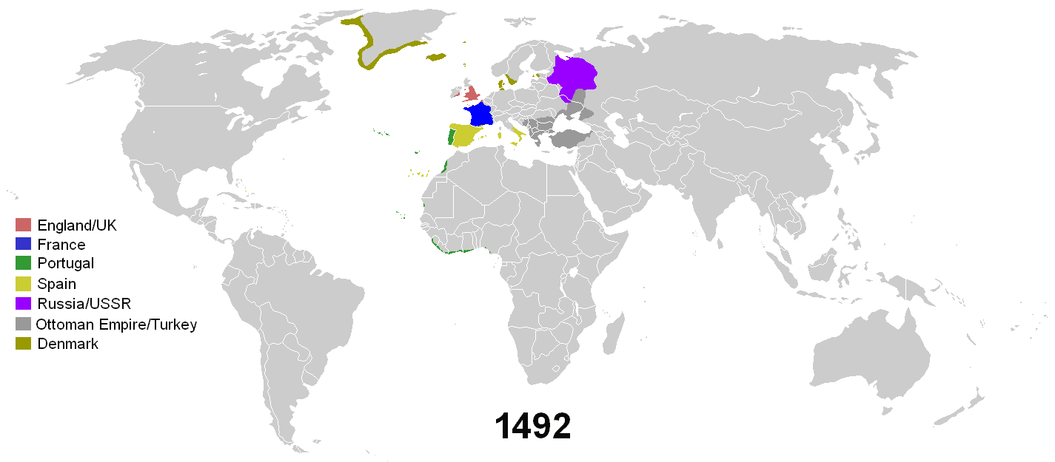
Figure 1: Empires from 1492-2008

Slide 10
WESTERN EUROPE versus CHINA in 1500
China had single centralized government, Western Europe was divided politically
China had meritocratic civil service versus European nepotism
China largely autarkic, not much external trade
China had labor-intensive rice economy vs. Europe’s land-based cereal and cattle economy
Europe had private banking
Europe had some advantages in navigation and weapons but not in other technologies

